Slide 1



What is XpressionWindow?
Ambarish Deshpande

Slide 2

Today’s Artists
How can I reach the right audience?
How do I create my own online space, where I can market my content?
How do I connect with other artists?
How do I increase my reach all over the world?
Artist
TODAY’S ARTISTS are often lost in the maze of unrelated content free-flowing on diverse social media platforms. ART FORMS, that share these already-crowded spaces with many other things, sadly REMAIN UNDERAPPRECIATED.
We, at XpressionWindow, have a solution that will change this picture..

Slide 3






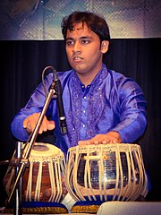
How XpressionWindow works?
Artist Own Space
Mimi’s Profile
Art-form Information
xpressionwindow.com
Mimi Johnson
I am a Singer. Watch my videos
Artists Profile
Artist
Mimi is also organizing a Workshop on Western Singing. She is getting amazing response on XpressionWindow
Artists Connections
Mimi wants to connect with other local artists for Band or Jamming.
Event Connections
Veena - The
Event Manager
Mimi is a Singer, wants to explore more avenues within Singing career
Workshops
Ram Sharma
Art Shops
Veena Organizing a Musical Event. She needs a Singer and Percussionist. She found it on XpressionWindow
Veena used XpressionWindow platform to sale the tickets for Mimi’s Event.
Professional Tabla Player
Blogs & Artforms Info
Other Artists
Global Presence

Slide 4

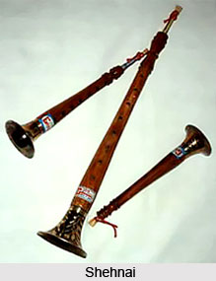
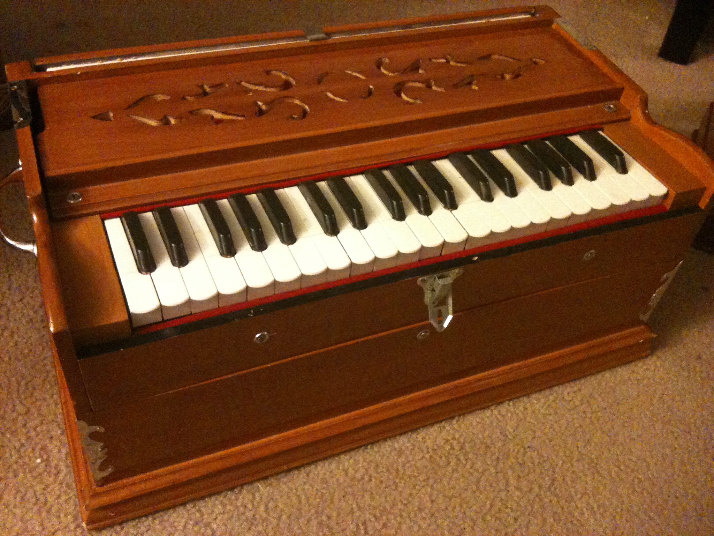

Thank you
The XpressionWindow Pvt. Ltd.
(+91) 727-654-7983
support@xpressionwindow.com
www.xpressionwindow.com

